Slide 1
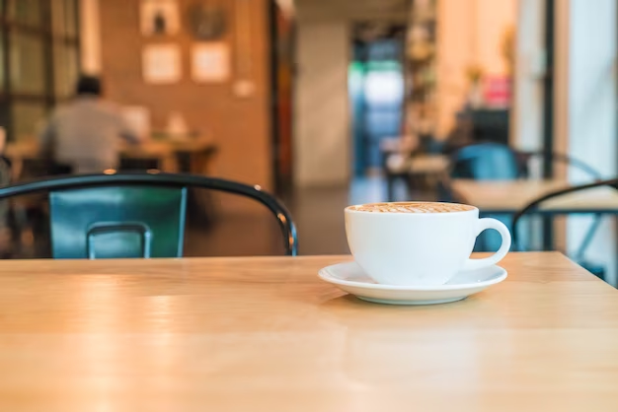
CAFe TABLE RESERVATION SYSTEM
GROUP-1

Slide 2
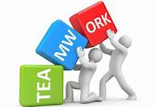
GROUP-1
USER-END
Ashutosh Mishra 2563968
Debasish Sahu 2563740
Pendhota Shyam Sunder 2563085
Chintapulusu Bhanu Priya 2564028
Meghana N 2563624
ADMIN-END
Chaitra R Bhat 2563097
Pendyala Akash 2563863
Adhithyan Vadakke Ellathu 2563314

Slide 3
AGENDA
Introduction
Tools & Languages used
ER-diagram
Outputs
Features
Advantages
Disadvantages
Future scope & improvements
Conclusion

Slide 4
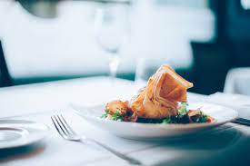
INTRODUCTION
Café table reservation is an Internet-based Java application that automates the working of a café that manage and maintain records of the customers.
The proposed project “Café Table Reservation” has been developed to overcome the problems faced in the practicing of manual system.
This web application is reduced as much as possible to avoid errors while entering data. It also provides error message while entering invalid credentials.
This application is a convenient self-service table & menu booking system. With this system the booking process can be customized, manage restaurant availability & reservations.
The services provided are menu & table booking managed by the customer through the system.

Slide 5

TOOLS & LANGUAGES USED
Front End
Back End
Visual Studio
Angular
HTML
CSS
BOOTSTRAP
Spring Boot
MySQL
Hibernate
Postman
Spring tool suite

Slide 6
ER DIAGRAM
Login
Admin
Add and remove items in menu
Homepage
Edit food items in menu
Enable & disable food items in menu
Register & login
User
Change Password
Choose ac/non ac room table
Add reserve tables
Logout
Search for tables
Update user

Slide 7
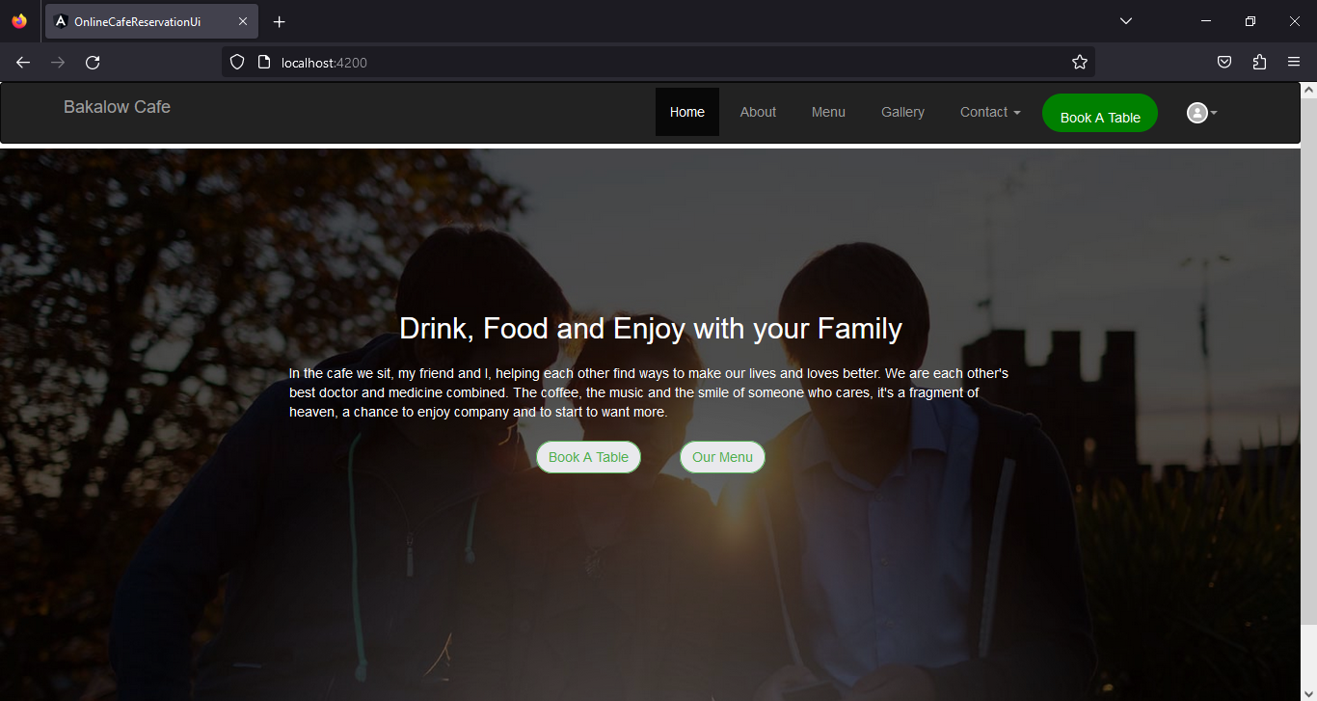
OUTPUTS
Home page:

Slide 8
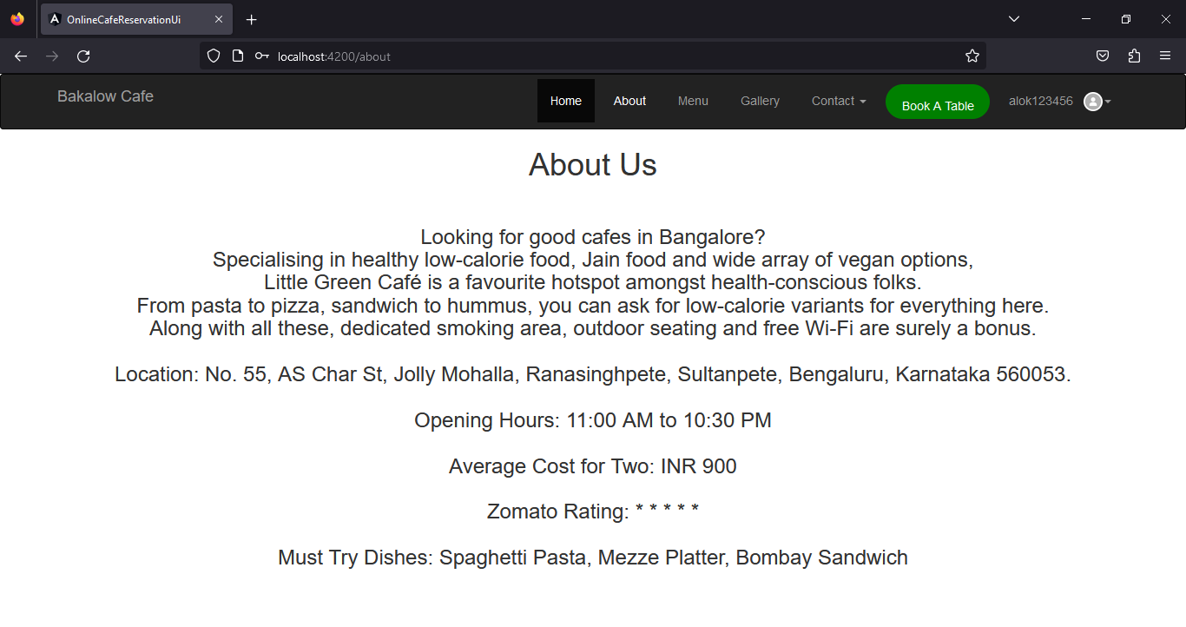
ABOUT US

Slide 9
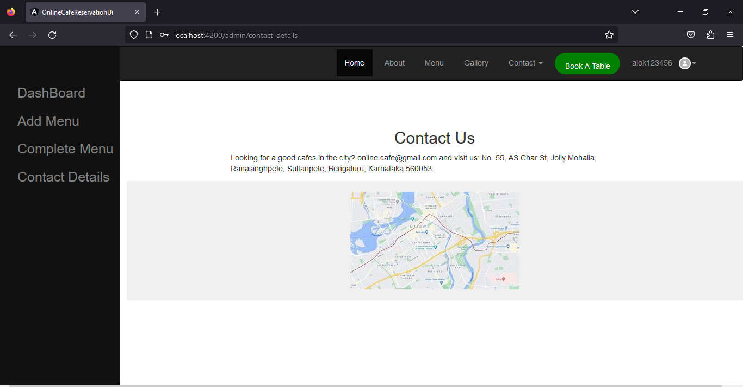
CONTACT US

Slide 10
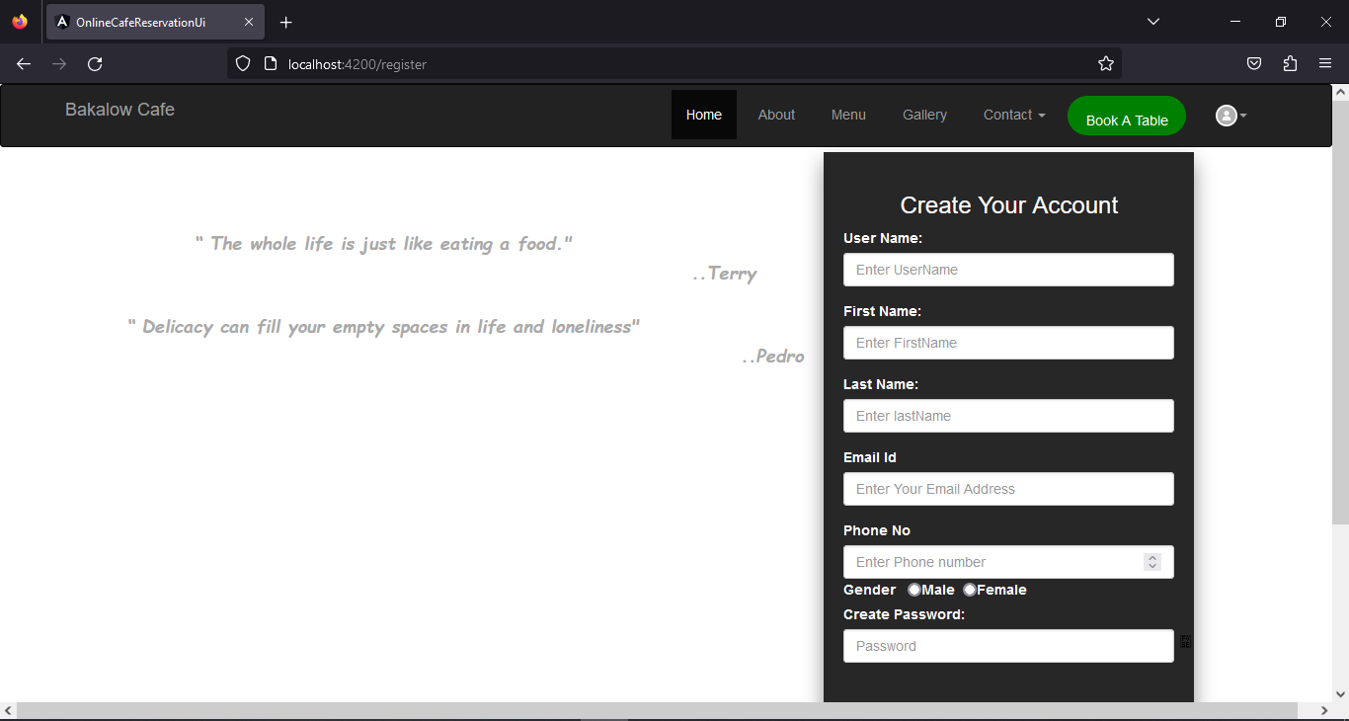
Registration

Slide 11
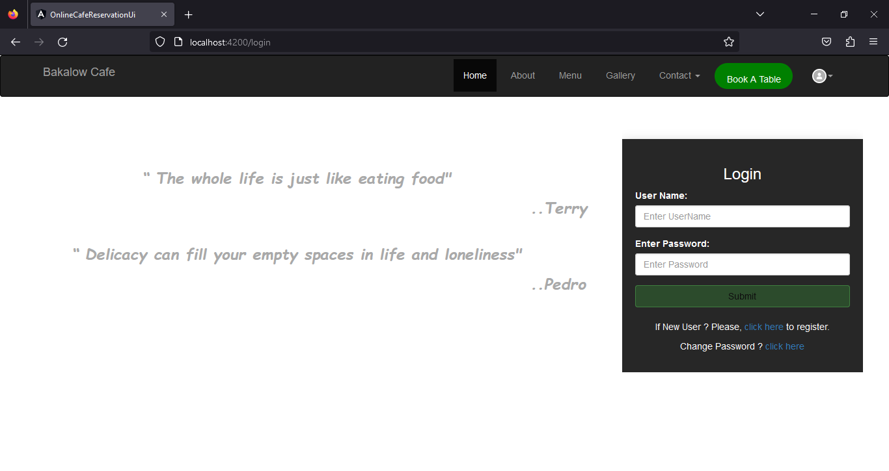
Login

Slide 12
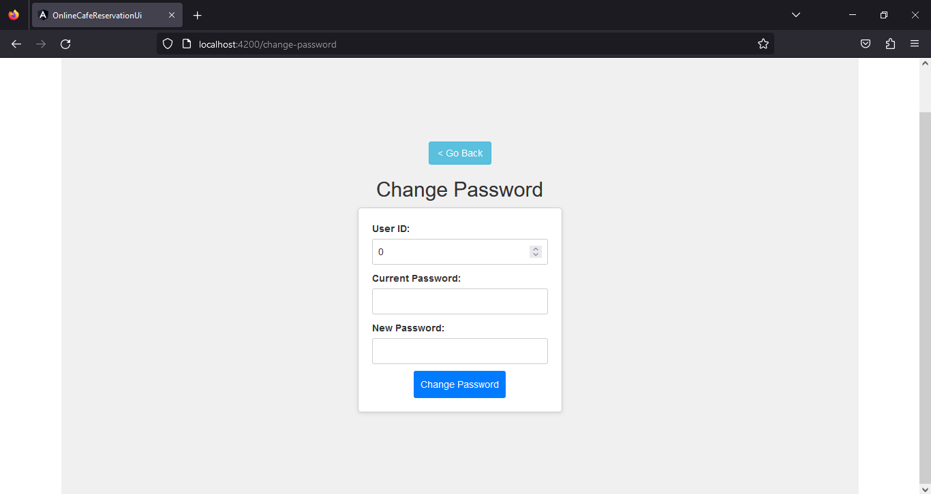
Change password

Slide 13
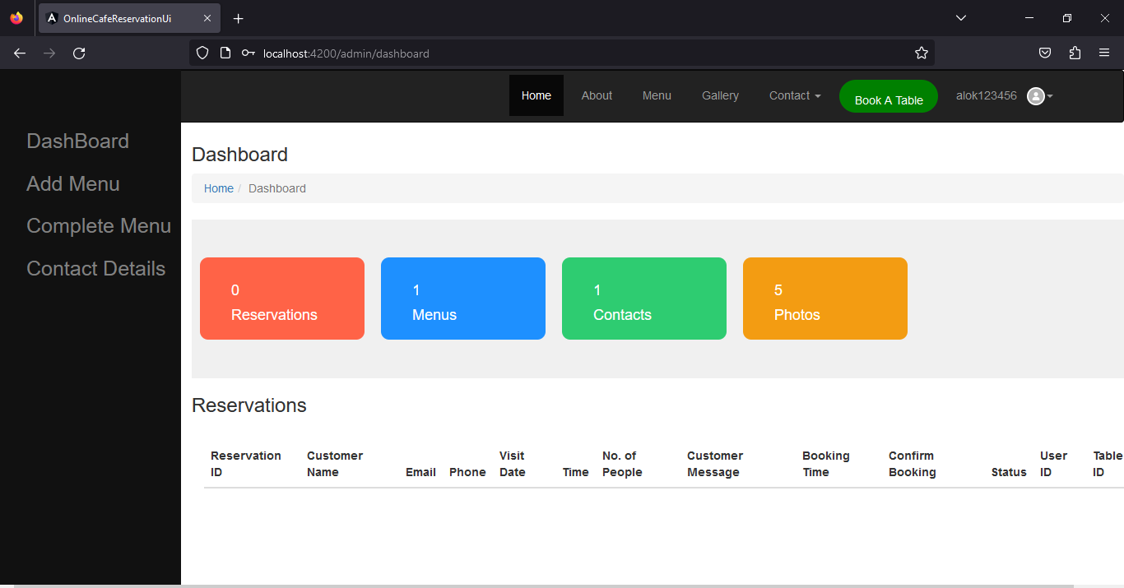
Admin dashboard

Slide 14
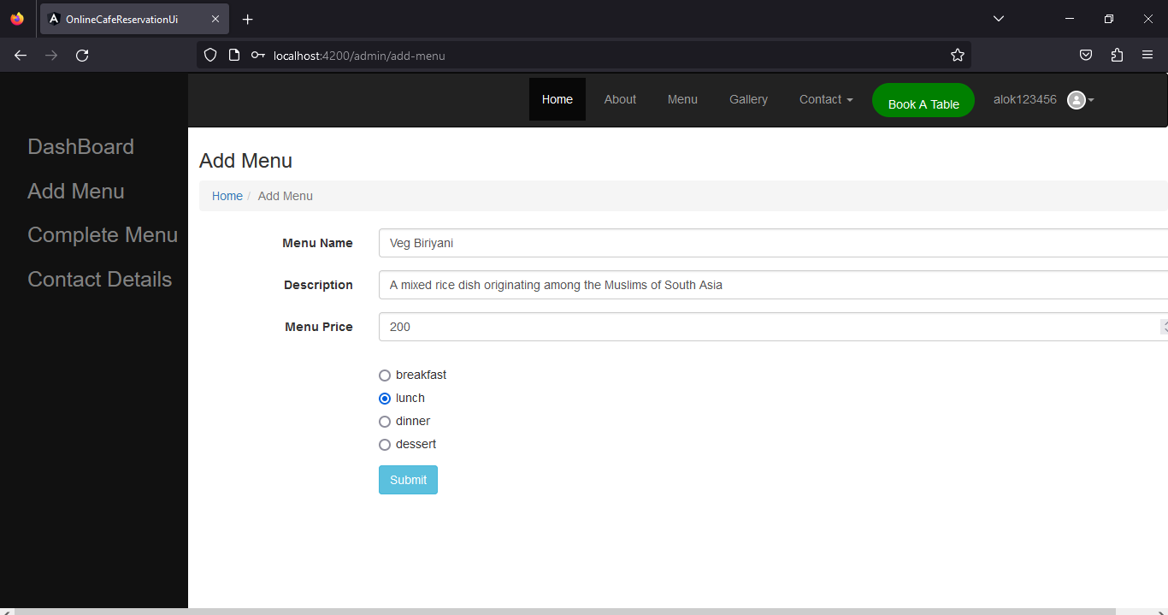
Add menu

Slide 15
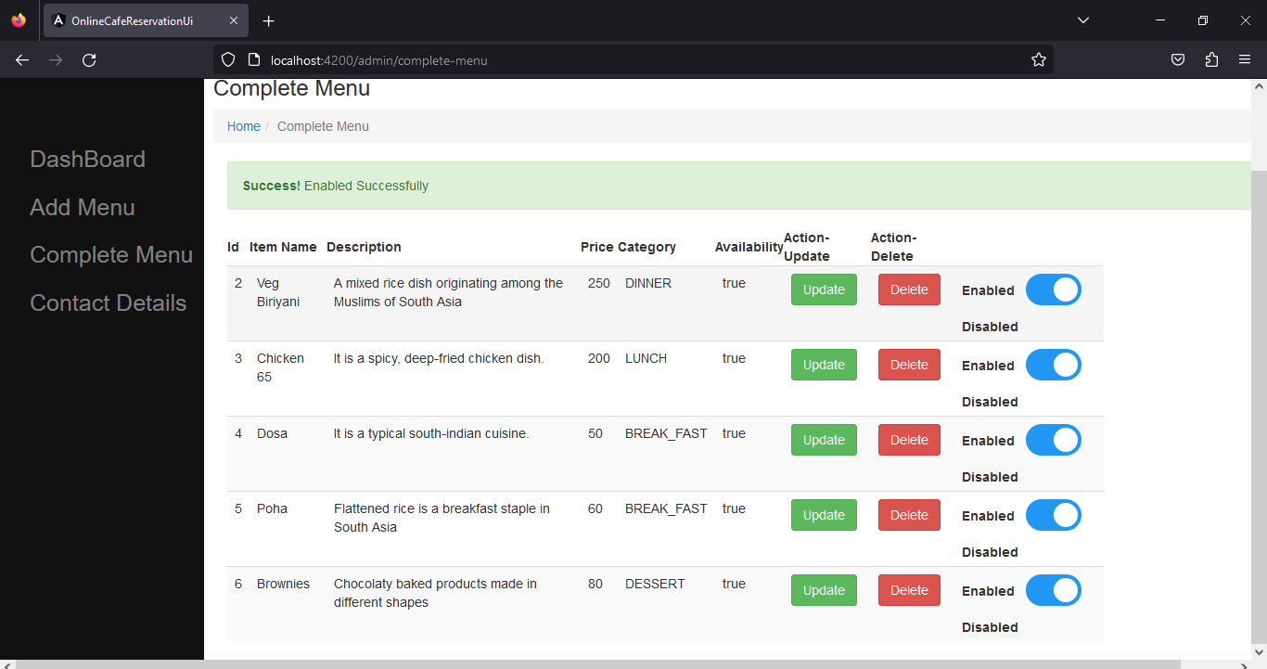
Complete menu

Slide 16
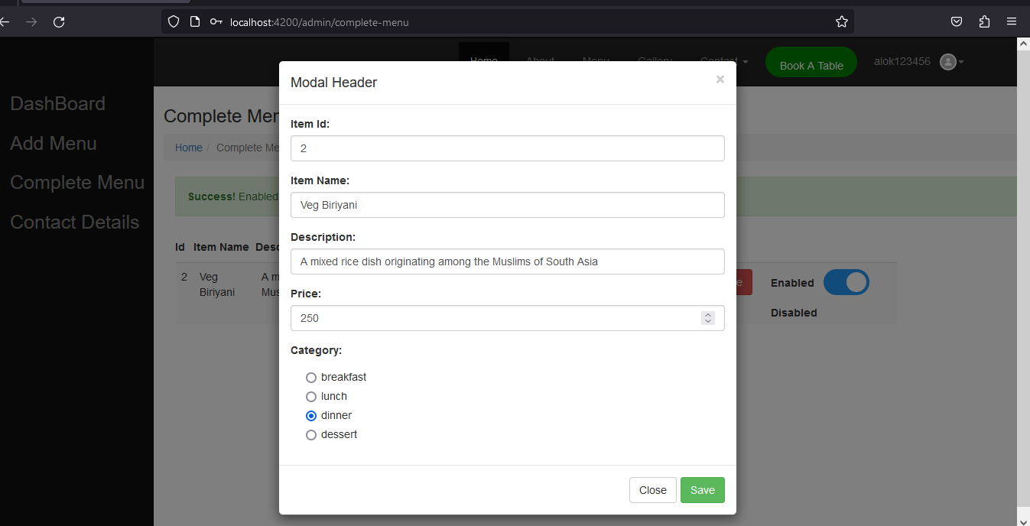
Edit items

Slide 17
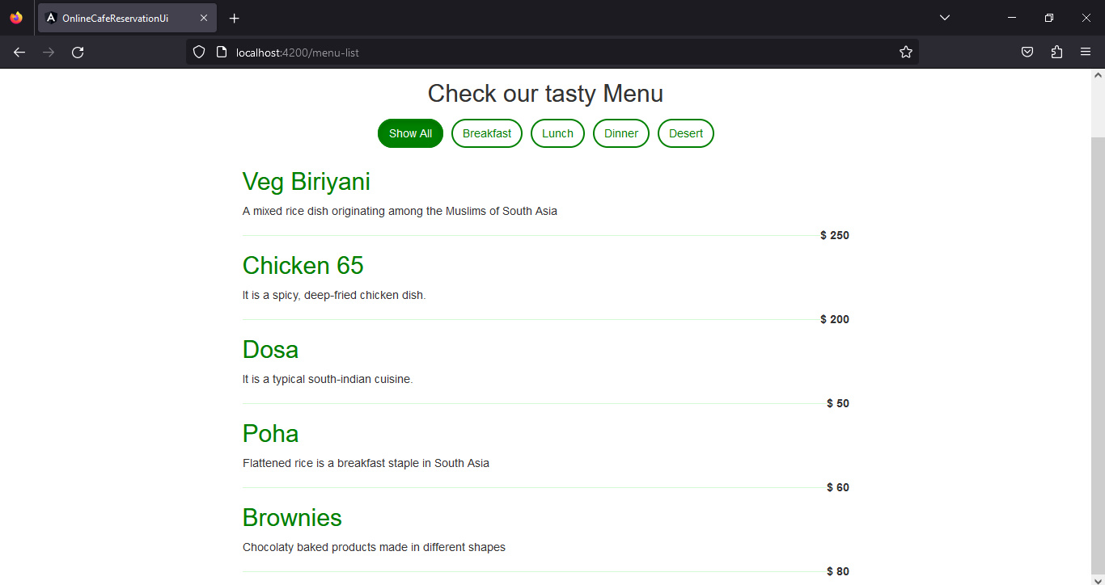
Menu list

Slide 18
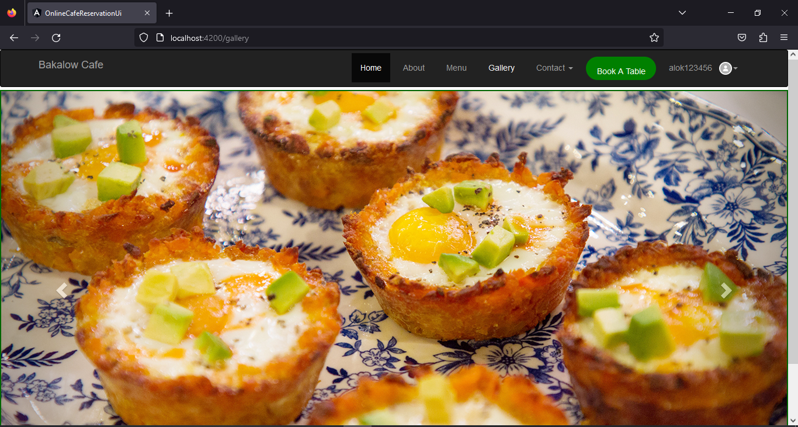
Gallery

Slide 19
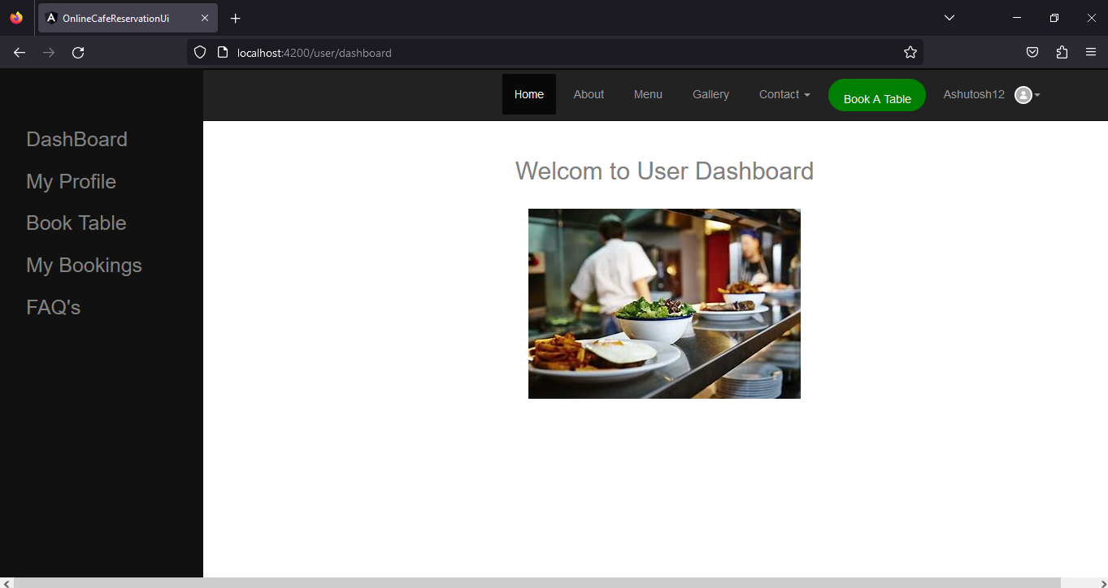
User dashboard

Slide 20
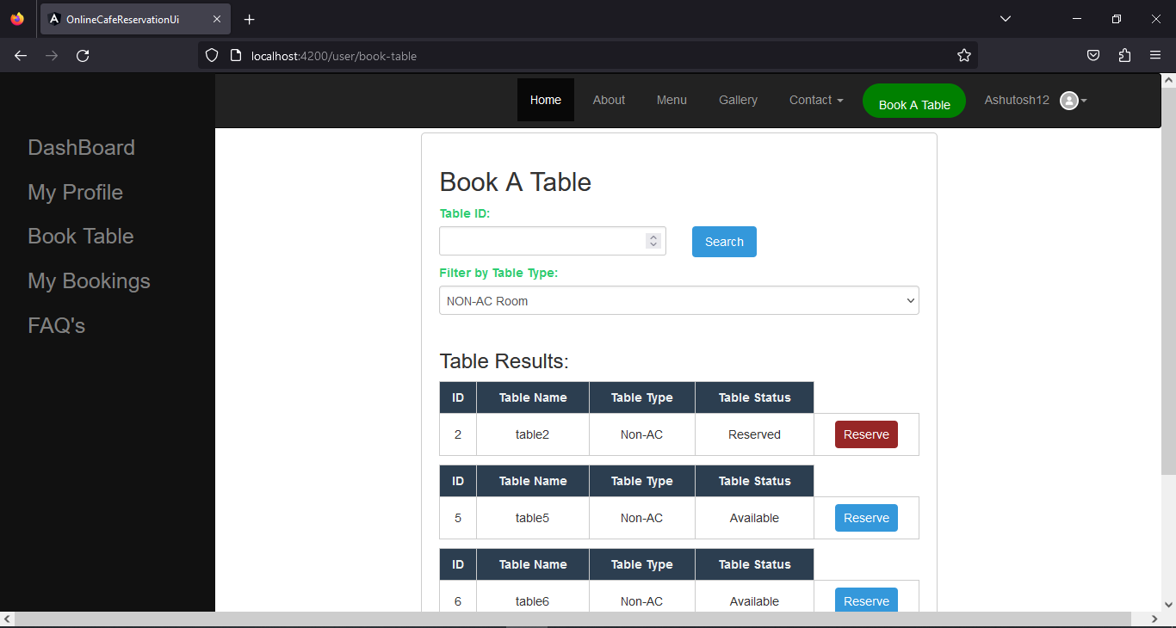
Book table

Slide 21
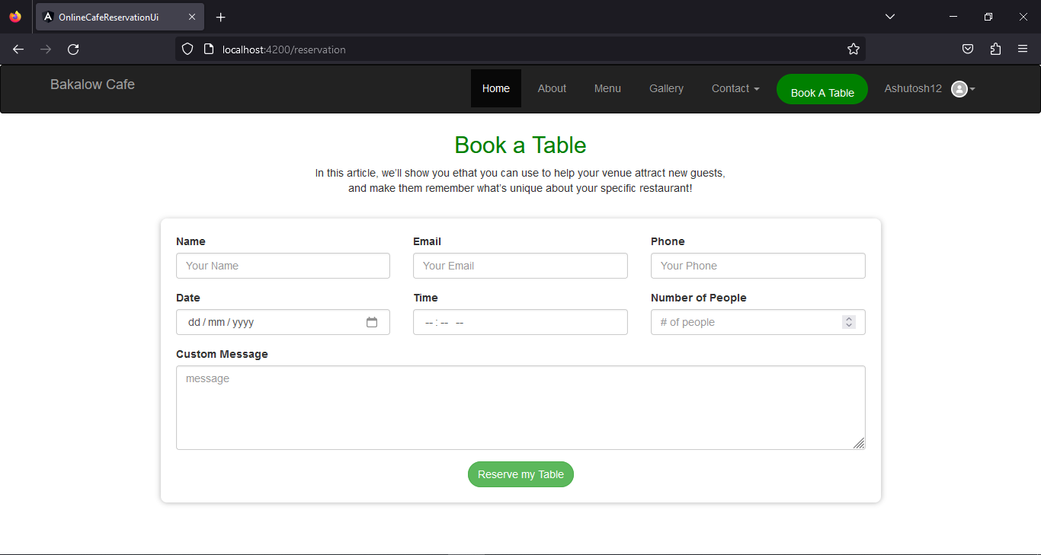
Booking details

Slide 22
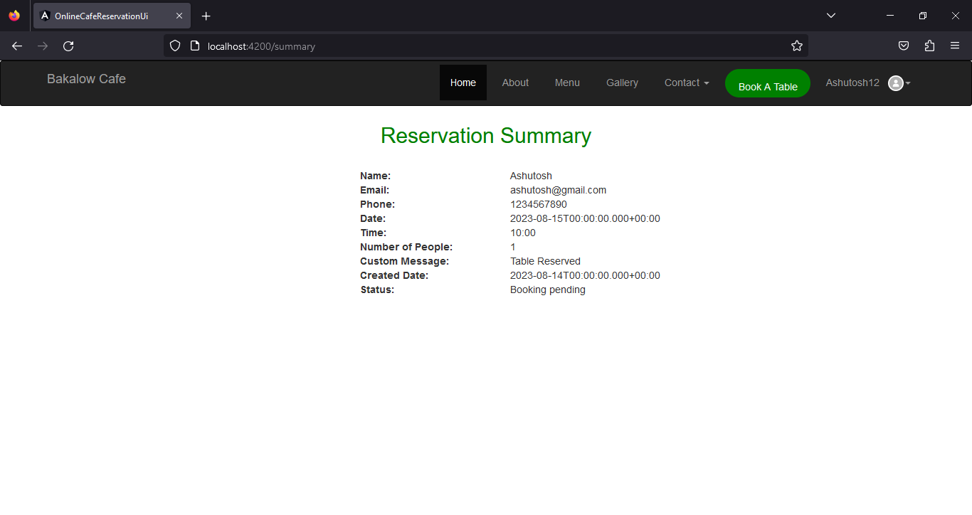
Reservation summary

Slide 23
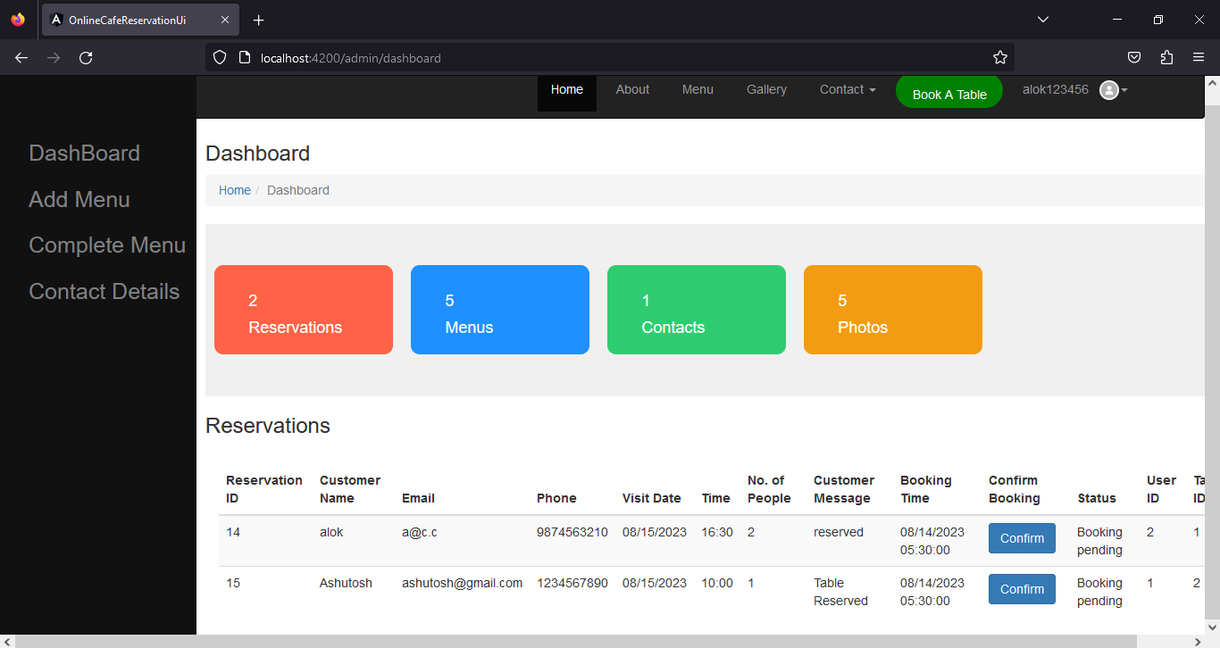
Confirm Booking

Slide 24
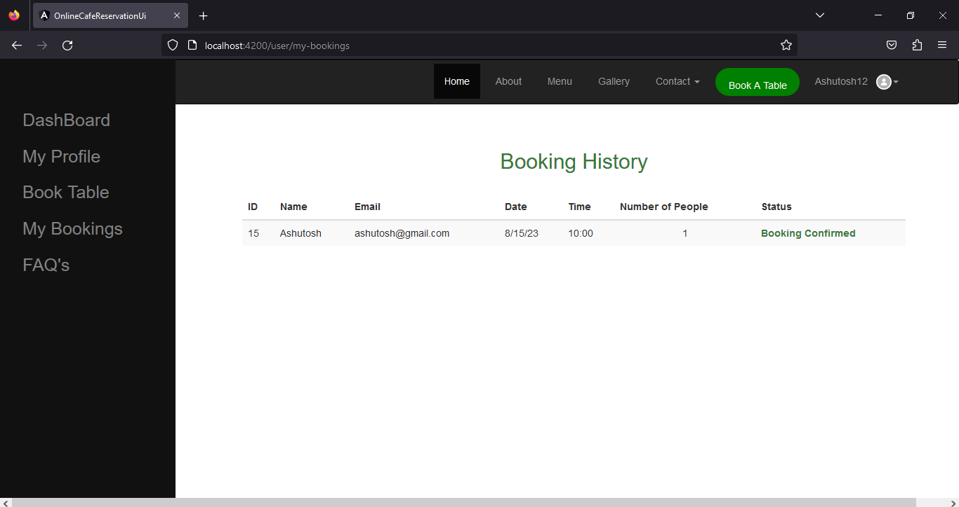
Booking history

Slide 25
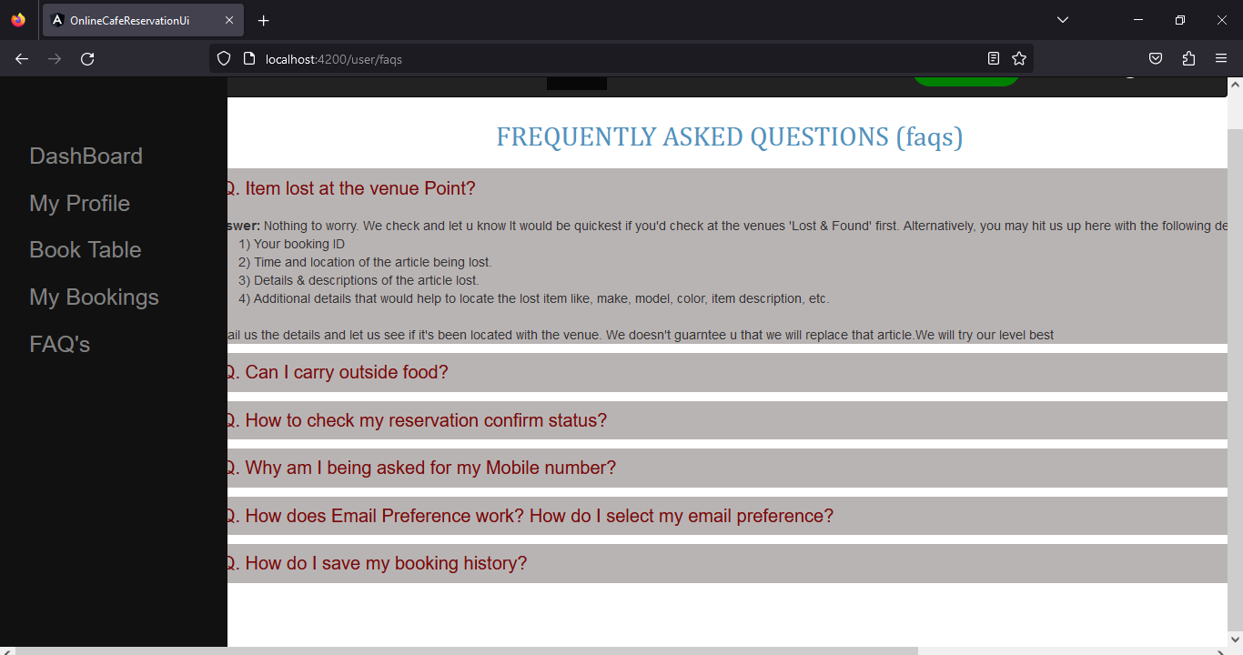
FAQs

Slide 26

Features
Easy to use.
This system is easily compatible with most of the web browsers.
Admin can view all the records whenever necessary with ease.
User-Friendly System
Easy Menu setup
Tracking sales

Slide 27
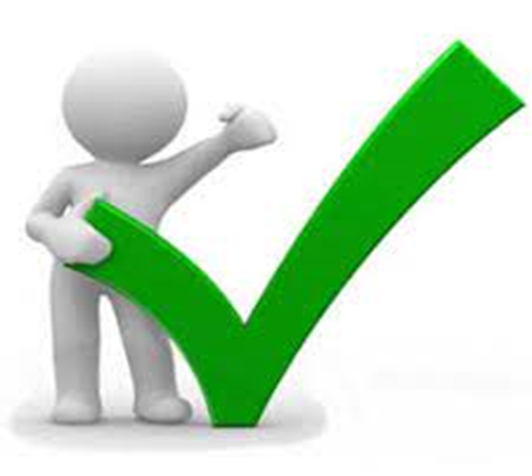
Advantages
Helps the customers to access their data.
The information related to customers can be added and removed easily.
Store the end-to-end data of the customers
Can easily update and edit menu details.

Slide 28

Disadvantages
Data security, loss and theft.
Cyber security and fraud.
Information access, quality and control

Slide 29

Future scope & improvements
The option to print the records In future.
This Application works in Multiple PC’s installed on multiple Computers but sharing Same database by which users of different department can use it sitting at different locations simultaneously.
But in future we can make the Application where the database will be hosted in order to manage the all departments which will be located in different places and by keeping domain of Application as Online.

Slide 30
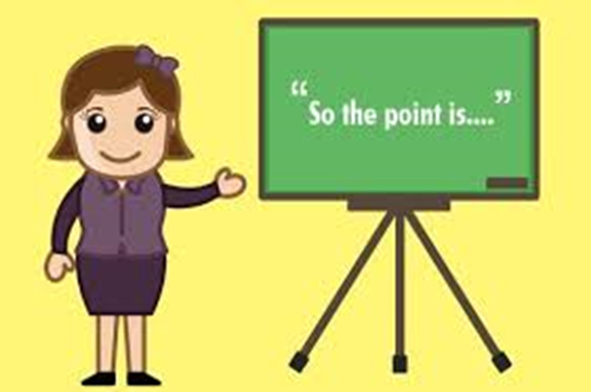
Conclusion
This project is built keeping in mind that it is to use by admin and the customers in an organization . According to the requested requirement the admin can add, manipulate, update and delete all employee data .The admin can add new customer and delete them. The required records can be easily viewed by the admin anytime time he wants in an instant. Numerous validations implemented would enable the admin to enter accurate data. The main objective of this framework is to save time, make the system cost effective and management records efficiently.

Slide 31
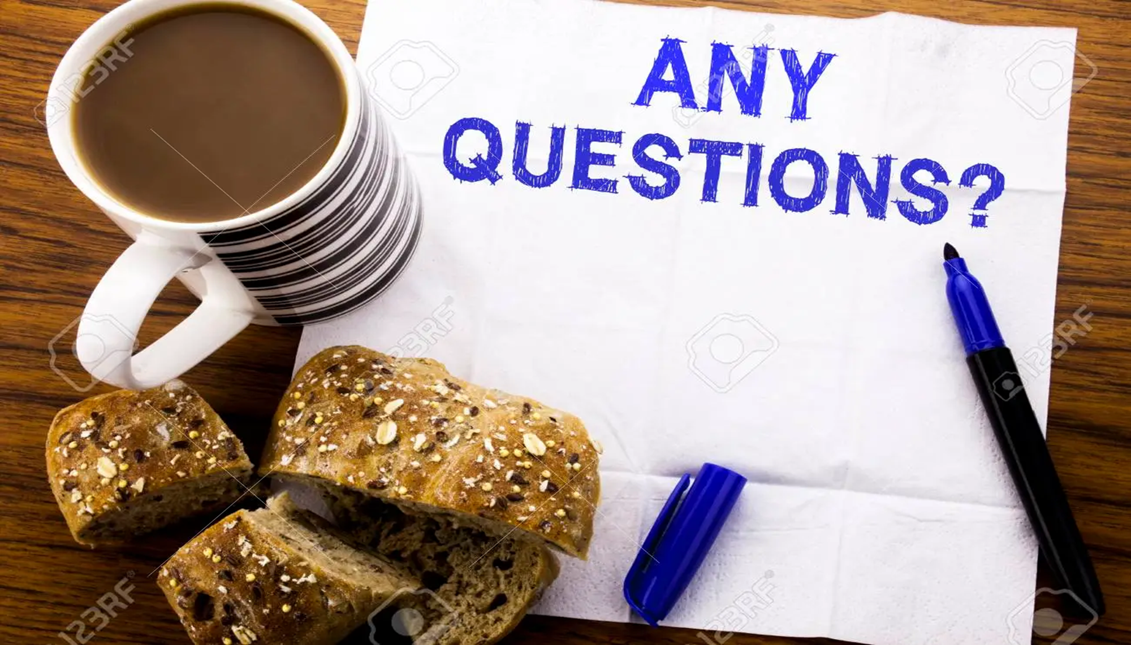


Slide 32


